Slide 1
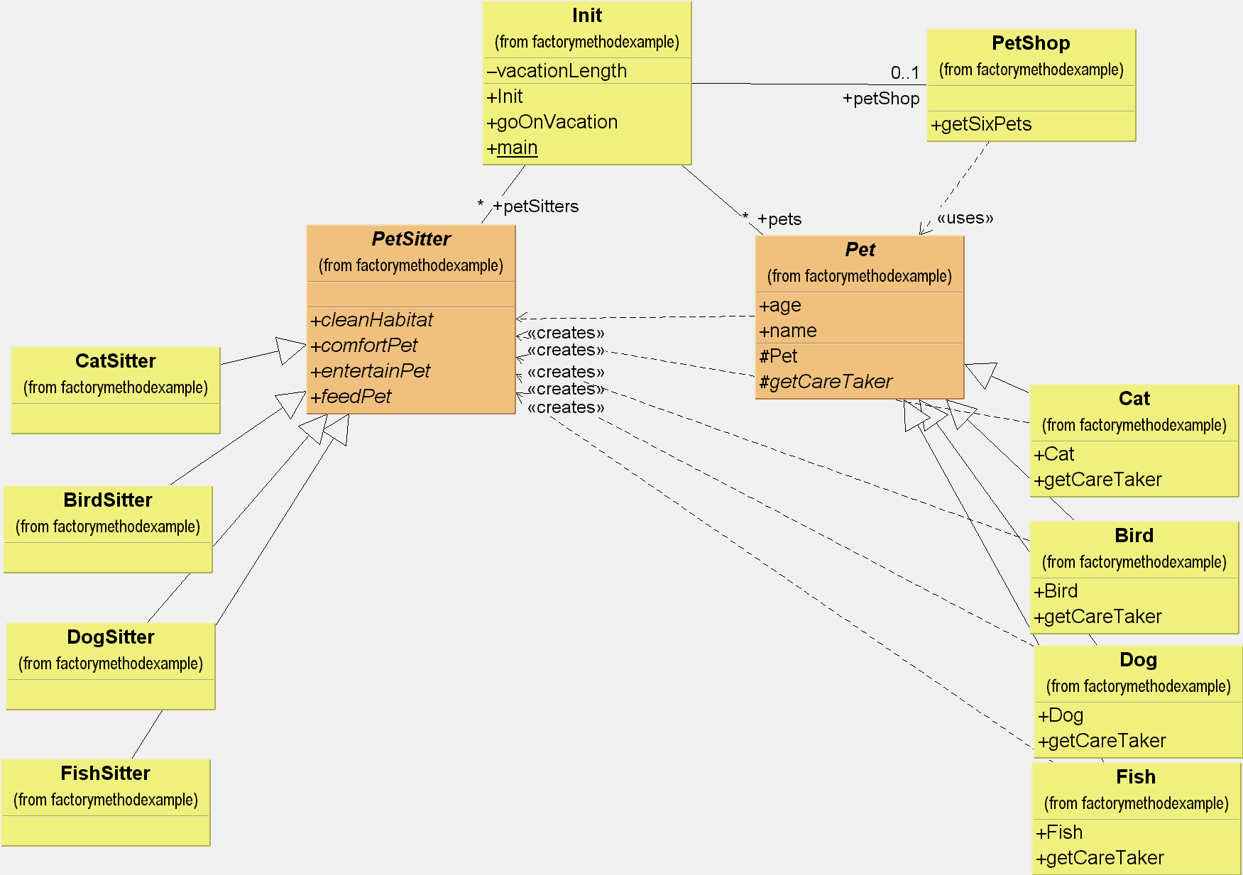
Week #8
Factory Method Pattern

Slide 2
Factory Method Pattern
CS 399 Design Patterns with Java
Go4 #3 HFDP #4
Week #8
Week #8
Factory Method Pattern

Slide 3
Intent
Define an interface for creating an object, but let subclasses decide which class to instantiate (Go4)
Week #8
Factory Method Pattern

Slide 4
Dilemma
Some class must instantiate an instance of another class, but has no knowledge of the specific subclasses.
For reasons of encapsulation and loose coupling, this information must remain unknown
How can the class create the proper needed object?
Week #8
Factory Method Pattern

Slide 5
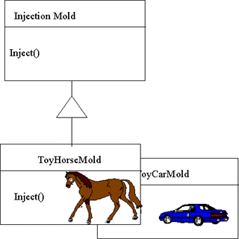
Conceptual Solution
Week #8
Factory Method Pattern

Slide 6
In Practice
Purpose
  dynamic creation through inheritance
When to use
  A class cannot anticipate which kind of class it must instantiate
  Object to create is specified by a subclass
  The system shall be opened for extension, but closed for modification
Week #8
Factory Method Pattern

Slide 7
Another Example: parallel class hierarchies
Factory Pattern is also useful in supporting parallel class hierarchies with information hiding
Instead of the top of the hierarchy knowing all the information, each sub-class in one hierarchy has a “connection” to the corresponding class in the parallel hierarchy
Week #8
Factory Method Pattern

Slide 8
Pet - Pet Sitter Example
Someone has way too many animals
Each animal requires special care
When he goes on vacation, he must secure a “specialist” to care for each type of animal
Wants to write general instructions to all caretakers.
Week #8
Factory Method Pattern

Slide 9
Another Example: parallel class hierarchies
Factory Pattern is also useful in supporting parallel class hierarchies with information hiding
Instead of the top of the hierarchy knowing all the information, each sub-class in one hierarchy has a “connection” to the corresponding class in the parallel hierarchy
Week #8
Factory Method Pattern

Slide 10
Pet - Pet Sitter Example
Someone has way too many animals
Each animal requires special care
When he goes on vacation, he must secure a “specialist” to care for each type of animal
Wants to write general instructions to all caretakers.
Week #8
Factory Method Pattern

Slide 11
Week #8
Factory Method Pattern

Slide 12
Structure
Creator
Product
FactoryMethod()
Concrete Creator
Concrete Product
FactoryMethod()
Week #8
Factory Method Pattern

Slide 13
Factory Method Example
Managing the New Releases at a Video Download Service
Small fixed number of different new releases
Each has its own “new releases” stream
New Releases are discounted
If all the new releases streams for that movie are used, the service will create a new one
Week #8
Factory Method Pattern

Slide 14
Classes Used
Video Download Service
  Contains several NewReleaseShelves
Online Buyer
  Decides which videos to make new release discount
New Release Page
  Determines when all streams are used and creates a new stream
Week #8
Factory Method Pattern

Slide 15
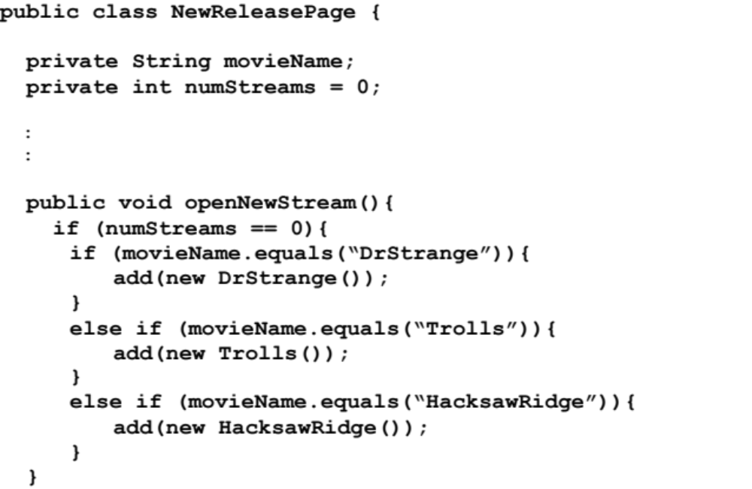
One Possible Implementation
Week #8
Factory Method Pattern

Slide 16
What’s Wrong with this Service?
The NewReleasePage has to know specific information about the new releases.
This means that every week(!) that software has to be rewritten - Gag!
Week #8
Factory Method Pattern

Slide 17
A Better Approach
Write the software for NewReleasePage such that it can handle new releases in a completely generic way
Now as each week goes by, the software is unchanged, only the things that must change are the things that frequently do change.
Week #8
Factory Method Pattern

Slide 18
Making this Work
Use a Factory Method Pattern!
Defer the creation of a new object to the sub-class that knows which object to create.
Creator NewRelease
Concrete Creator Dr Strange 2016
Factory Method createNewRelease()
Week #8
Factory Method Pattern

Slide 19
Factory Method Mechanism
NewReleasePage has no knowledge of actual new releases, treats them polymorphically
Abstract class NewRelease has abstract method -- createNewRelease
Each sub-class of NewRelease (i.e. Dr Strange) overrides createNewRelease with one that specifically creates itself
Week #8
Factory Method Pattern

Slide 20
Benefits
NewReleasePage software remains stable
When a NewRelease arrives, only changes necessary are made by those initiating the change (OnlineBuyer, “grunt” programmer)
Week #8
Factory Method Pattern

Slide 21
Another Example
Go4 book has a maze example in C++
Bob Tarr translated this example into Java
  First program demonstrates the inflexibility
  Second program illustrates the benefit of the factory method pattern
Week #8
Factory Method Pattern

Slide 22
public class MazeGame {
public Maze createMaze() {
Maze maze = new Maze();
Room r1 = new Room(1);
Room r2 = new Room(2);
Door door = new Door(r1, r2);
maze.addRoom(r1);
maze.addRoom(r2);
r1.setSide(MazeGame.North, new Wall());
r1.setSide(MazeGame.East, door);
r1.setSide(MazeGame.South, new Wall());
r1.setSide(MazeGame.West, new Wall());
r2.setSide(MazeGame.North, new Wall());
r2.setSide(MazeGame.East, new Wall());
r2.setSide(MazeGame.South, new Wall());
r2.setSide(MazeGame.West, door);
return maze;
}
}
Week #8
Factory Method Pattern

Slide 23
public class MazeGame {
public Maze makeMaze() {
return new Maze();
}
public Room makeRoom(int n) {
return new Room(n);
}
public Wall makeWall() {
return new Wall();
}
public Door makeDoor(Room r1, Room r2) {
return new Door(r1, r2);
}
}
Week #8
Factory Method Pattern

Slide 24
public Maze createMaze() {
Maze maze = makeMaze();
Room r1 = makeRoom(1);
Room r2 = makeRoom(2);
Door door = makeDoor(r1, r2);
maze.addRoom(r1);
maze.addRoom(r2);
r1.setSide(MazeGame.North, makeWall());
r1.setSide(MazeGame.East, door);
r1.setSide(MazeGame.South, makeWall());
r1.setSide(MazeGame.West, makeWall());
r2.setSide(MazeGame.North, makeWall());
r2.setSide(MazeGame.East, makeWall());
r2.setSide(MazeGame.South, makeWall());
r2.setSide(MazeGame.West, door);
return maze;
}
}
Week #8
Factory Method Pattern

Slide 25
public class FantasyMazeGame extends MazeGame {
public Room makeRoom(int n) {
return new EnchantedRoom(n);
}
public Wall makeWall() {
return new InvisibleWall();
}
public Door makeDoor(Room r1, Room r2){
return new OneWayDoor(r1, r2);
}
}
Week #8
Factory Method Pattern

Slide 26
Maze Example Summary
Using new makes hardwired code
Using Factory Method pattern adds great flexibility
  the make maze code can be used without modification to create a Maze or an FantasyMaze or a SpyMaze, etc.
The subclasses determine the exact object to be created (“new” commands buried in class hierarchy
Week #8
Factory Method Pattern

Slide 27
Conclusion
FactoryMethod Pattern hides concrete specifics from higher levels
Coordinating class can create specific low-level objects in a generic way
Supports information hiding, encapsulation and extensibility
Week #8
Factory Method Pattern

Slide 28
Discussion
How does Factory Method promote loosely coupled code?
Make a list of possibly instances in which the Factory Method pattern could be employed
Week #8
Factory Method Pattern

